Slide 1
Feature Analysis to League of Legends Victory Prediction on the Picks and Bans Phase
Lincoln M. Costa, Rafael G. Mantovani, Francisco Carlos M. Souza, Geraldo Xexéo.
PESC/COPPE
costa@cos.ufrj.br

Slide 2
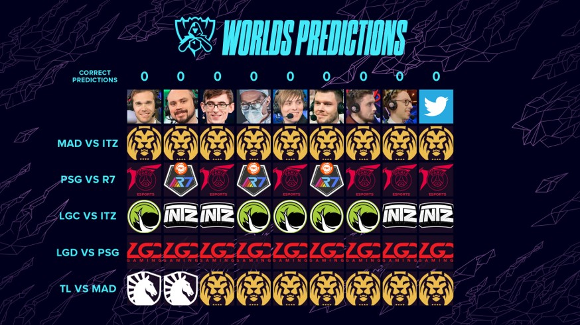
League of Legends victory prediction
Notes:
Falar que predições e palpites são antigos e realizados frequentemente

Slide 3

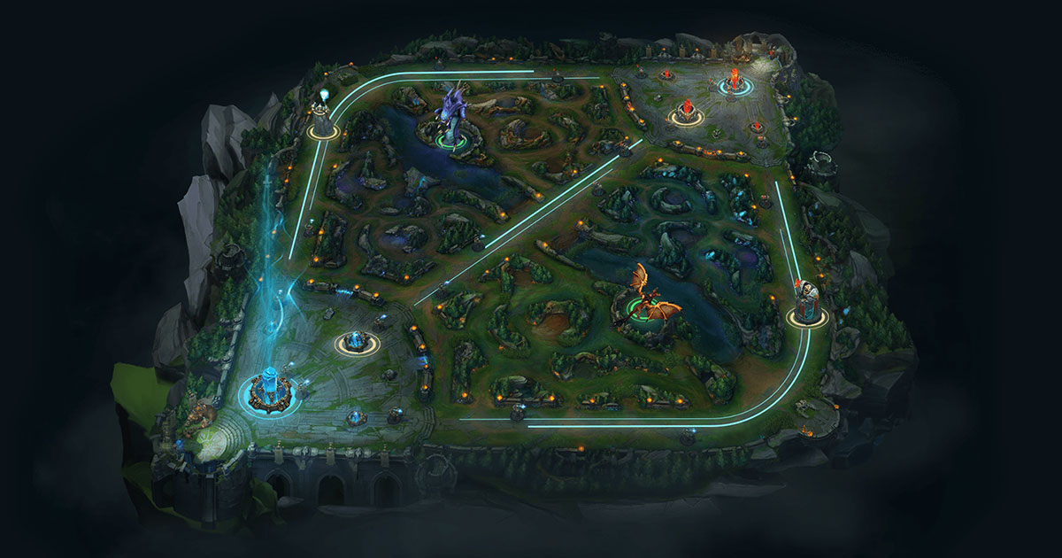
League of Legends

Slide 4
Related work
Victoria Hodge et al. (2019) focused on the audience experience while watching DOTA 2 games and aims to explain professional esports matches to the spectators as the matches progress by accurately predicting the winner throughout the game. They achieved 85% of accuracy after 5 minutes of gameplay.
Using RNN, Silva, Pappa, and Chaimowicz (2018) studied the prediction of League of Legends in specifics time interval and reached 83% in the interval of 20 to 25 minutes.
Kim, Lee, and Chung (2020) proposed a confidence-calibration method for predicting the winner of League of Legends matches.

Slide 5
Methodology: datasets
Dataset | Description
Banned Champions | Champions banned by both teams and the match result
Picked Champions | Champions selected by both teams and the match result
Players Statistics | Performance history of the players with the champions they selected for the game
Picked Champions and Players Statistics | Merge two of the datasets with best performance (Picked and Statistics)
Complete | Merge all the three datasets aforementioned (Banned, Picked and Statistics)

Slide 6
Methodology: algorithms and experimente design
The following algorithms were considered: Logistic Regression (LR), Decision Trees (DTs), Naive Bayes (NB), k-Nearest Neighbors (kNN), Random Forest (RF), and Support Vector Machines (SVMs).
Each algorithm was performed using a 10-fold cross-validation (CV) resampling with 5 repetitions using different seeds. In addition, the data was stratified to ensure the same distribution of classes on each partition.
AUC used as performance measure.

Slide 7
Results
Our models achieved 0.97 of AUC using Random Forest and Logistic Regression algorithms with Picked Champions and Players Statistics Dataset.
Datasets containing details about Banned Champions and Picked Champions are not descriptive enough to provide useful information of the matches’ results.

Slide 8
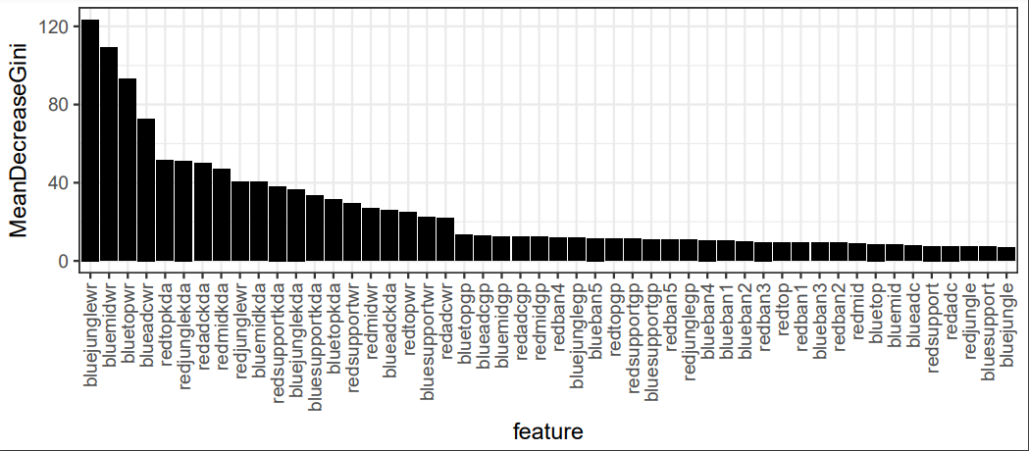
Feature importance

Slide 9
Conclusion and future work
Predicting the results of League of Legends professional matches from Picks & Bans (draft) phase is a valuable, interesting and solvable problem.
However, more research into prediction confidence is necessary.
In our future research we intend to concentrate on using the same features on different games like DOTA 2.

Slide 10

Thank you!
Lincoln M. Costa
PESC/COPPE
costa@cos.ufrj.br

